Slide 1
Bike airbag system that includes speed controller system along with identification and alerting system.
Under the supervision of Prof. Sreyashi Roy Ma'am
Submitted by :- Utsav Anand (2004174)​
Sudhanshu Ranjan (2004170)​
Raushan Kumar (2004157)​
Sikandar Kumar (2004323)

Slide 2
INTRODUCTION
In India a lot of road accident are occur. Bike accident play a major role in the accidents.
The bike riders are more affected in the accidents . So we planned to set airbag on the bike that also includes speed controller and if somehow accident occur than identification and alerting system help nearby hospital and police station to reached out and save the life.
It really reduce the injuries that occurred due to bike accident.

Slide 4
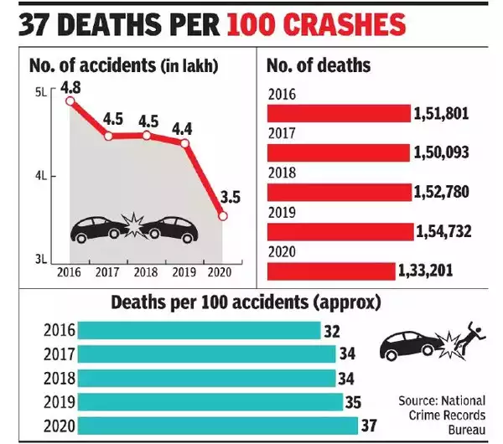
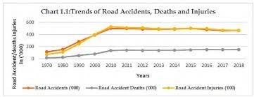
Graph>> Accidents occurred due to bike accidents

Slide 5
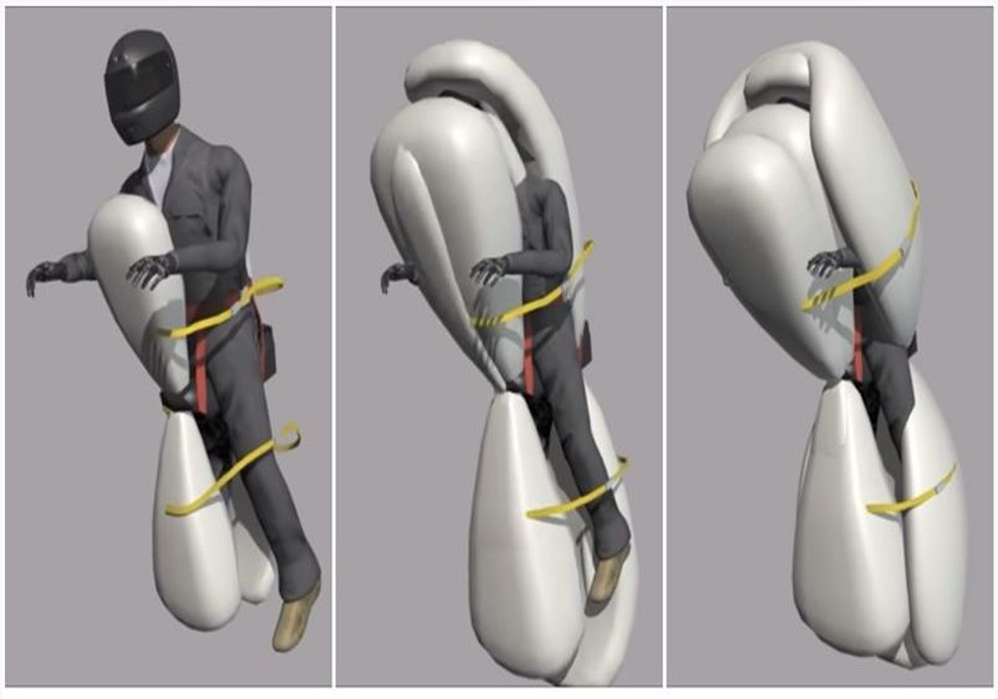
Applications :-
This project divided into three types:-
Airbag System for bike
Speed controller in E-bike
Identification and Alerting

Slide 6
AIRBAG SYSTEM OF BIKE
Airbag for Bike is a revolutionary motorcycle safety system which deploys an airbag that surrounds the rider.
The motorcycle ejection airbag incorporates a belt system that is designed to be less intrusive than a seatbelt in a car. There's no need for a special jacket or complicated gear. The rider simply attaches the lap belt on the motorcycle and is ready to ride safely. Using smart electromagnetic technology, the buckles on the rider automatically release if the rider wants to jump off of the motorcycle in a low risk scenario. The motorcycle ejection airbag system also knows not to deploy if the rider is not in serious danger.

Slide 7
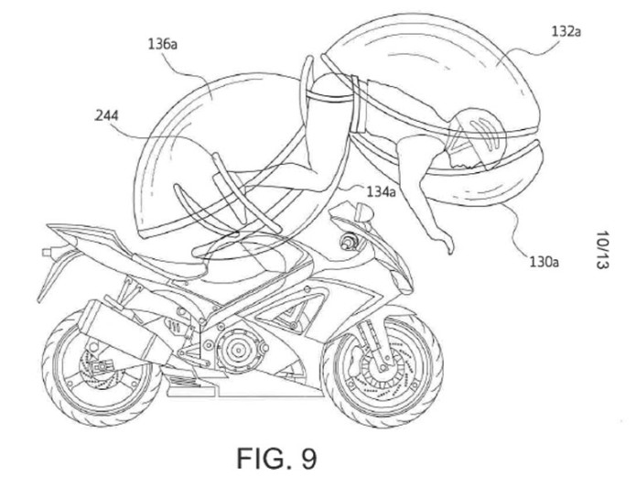
The buckle does not strap the rider to the seat, but rather, in case of an accident, the straps gently hold the airbag to the rider while it forms a protective cocoon around him.
The airbag stays inflated for a couple of seconds after the accident and then deflates to allow the passenger to move to a safe location.

Slide 8
Sensors used and its application
Crash sensors:- Its located on front mudguard and back mudguard
Seat occupy sensors:- Its located on seat
Pressure sensor:- Front wheel center
Ultrasonic Sensor:- Handlebar of the bike

Slide 9
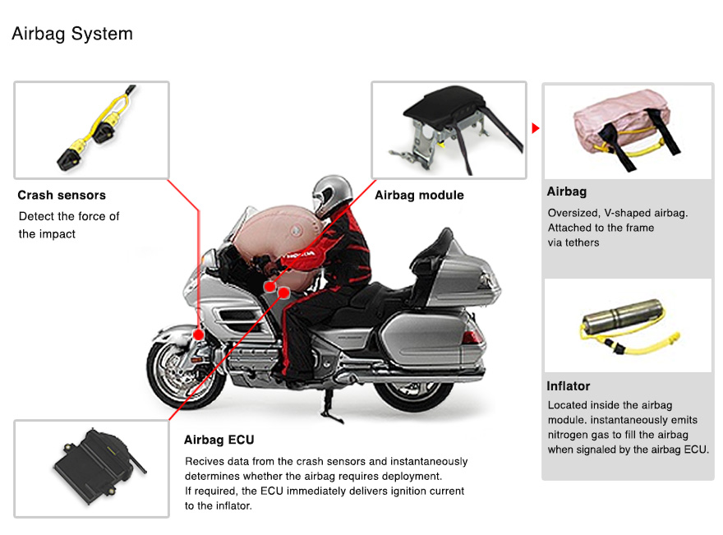
Airbag System for bike​

Slide 10
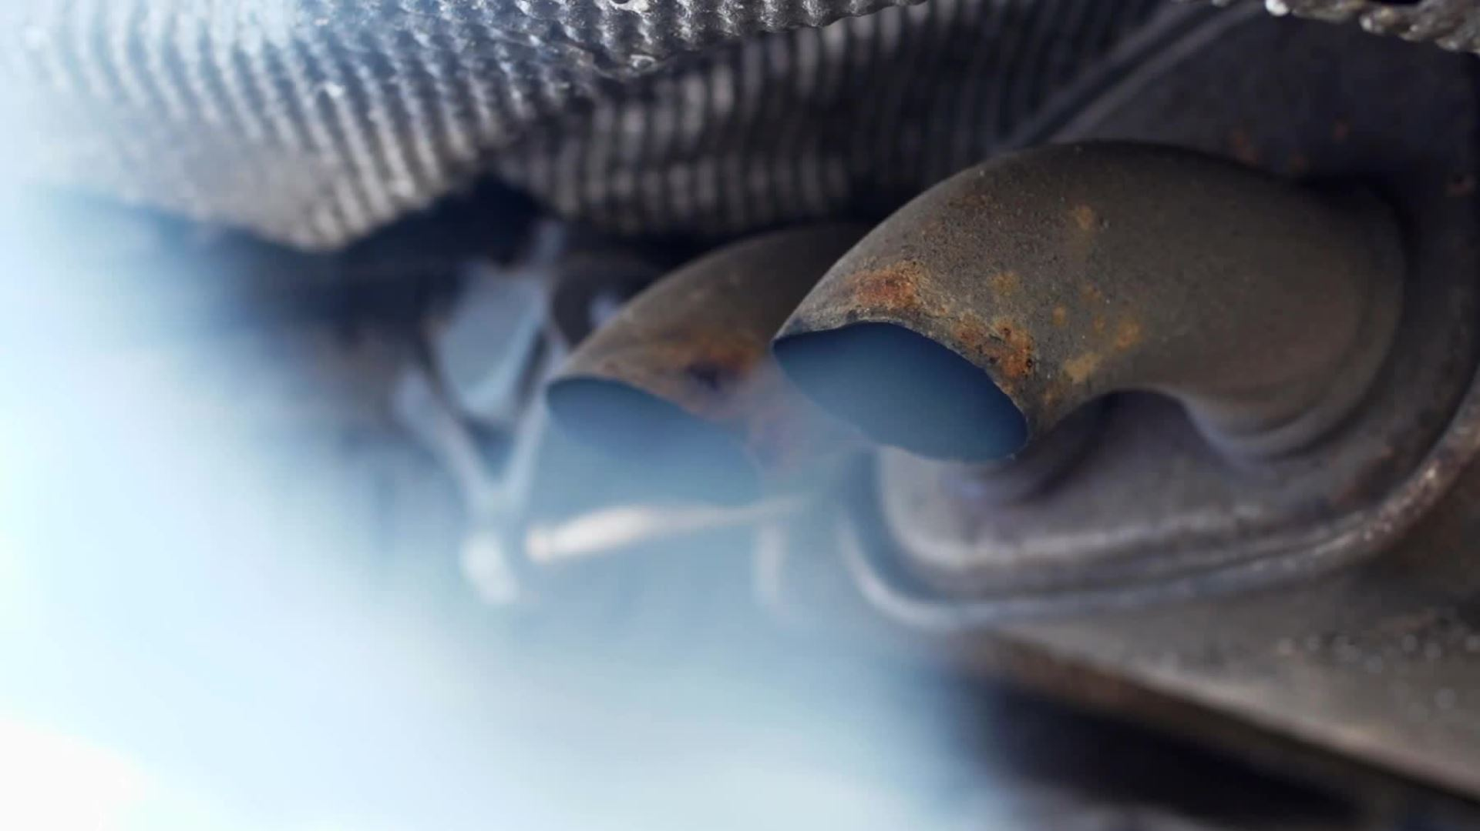
Condition for opening the airbag

Slide 11
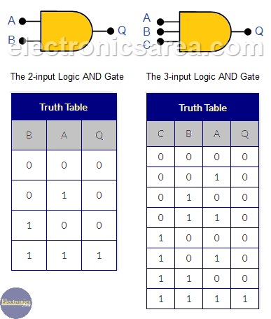
AND GATE:-
AND gate is used for opening airbag
If the three sensors are activate at a time then it satisfies the AND gate conditions
If the condition satisfies then the signal is send to ECU
ECU send the signal to the airbag

Slide 12
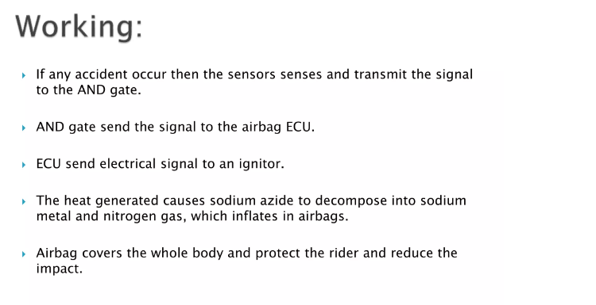

Slide 13
Speed controller in E-bike
E-bikes are the transport medium of our future. We are moving towards the electric vehicles era leaving behind the fuel based mechanisms.
Well in case of e-bikes there are 3 major components required:-
E-bike Motor
E-bike Battery
E-bike Controller

Slide 14
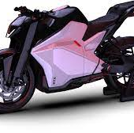
Working principle
The system makes use of an STM32 controller along with a throttle input, speed sensor for tyre speed, switch, motor driver, e-bike motor, battery and OLED display to develop the system.

Slide 15
EXPECTED Components
Stm32 Controller
Battery
Throttle
Speed Sensor
OLED Display
E-bike Motor
Motor Driver
Buzzer
LED’s
PCB Board
Resistors
Capacitors
Transistors
Cables and Connectors

Slide 16
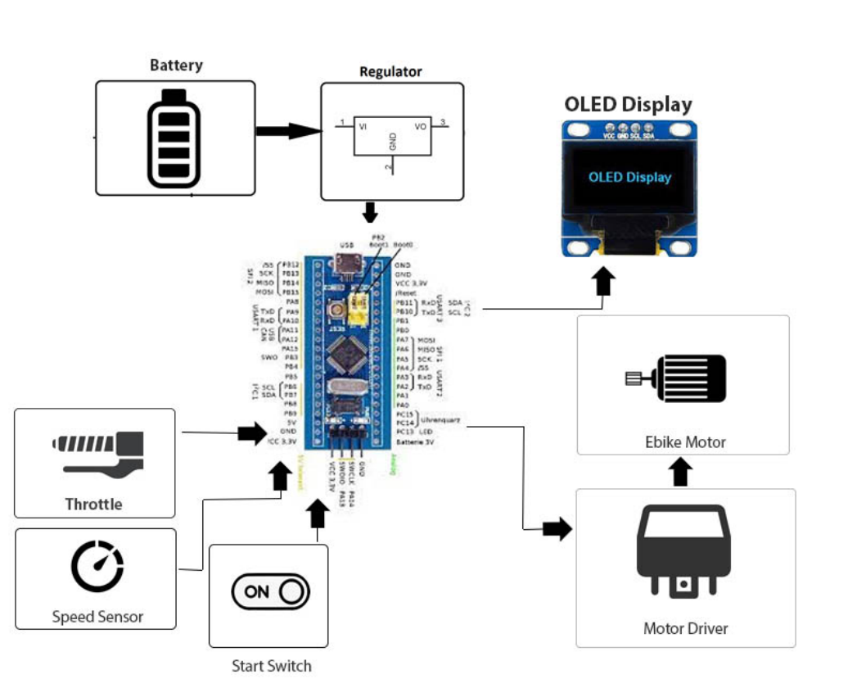
MICROCONTROLLER

Slide 17
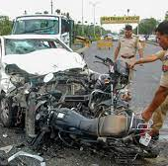
Identification and tracking system
When an individual riding his/her bike, meets with an accident, there is a chance that the individual may suffer from a serious injury or expire instantaneously and there is no one around to help him.
The system acts as an accident identification system that gathers and sends this vehicle information that met with an accident, and conveys it to the nearest control room.

Slide 18
WORKING PRINCIPLE
Vehicle is fixed with an RF transmitter circuit that has a vibration sensor along with microcontroller, RF encoder and also fitted with an RF transmitter
Each and every control room must have an RF receiver fitted to receive the transmission. Whenever a user vehicle meets with any accident, the vibration sensor detects and gives its output

Slide 19
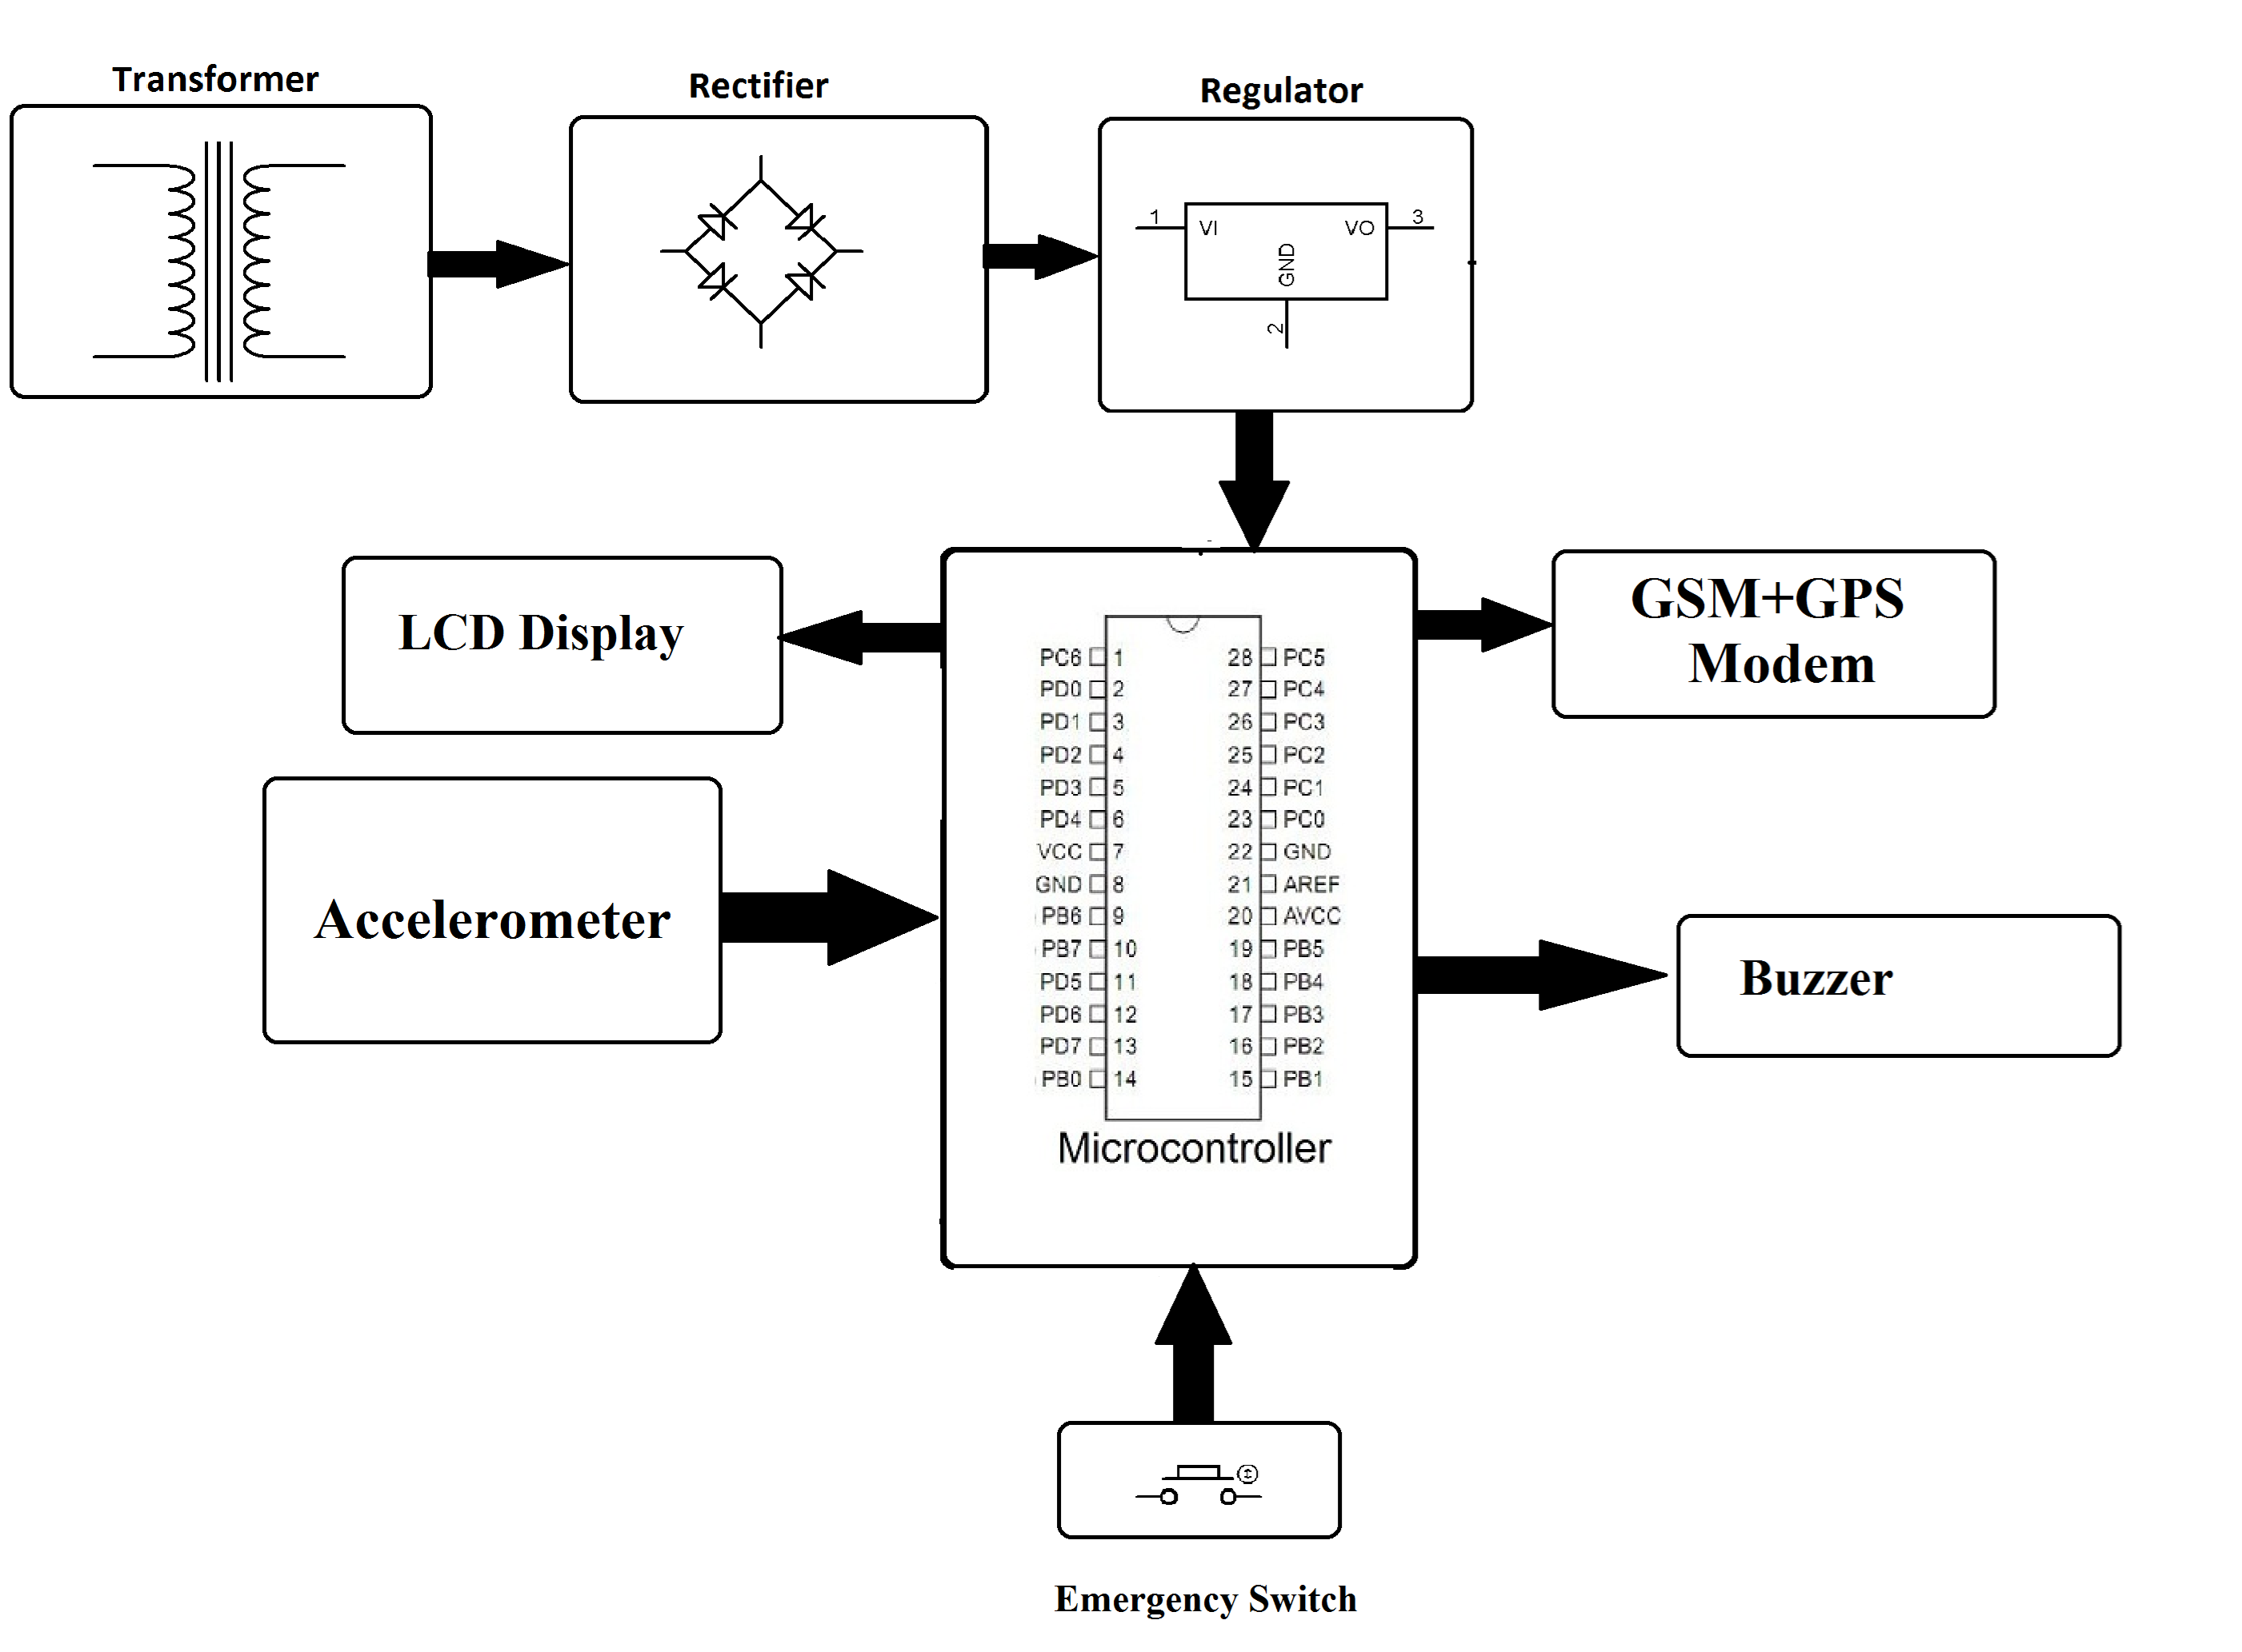
Block diagram
MICROCONTROLLER

Slide 20
Hardware specifications
Atmega Microcontroller
SIM 800 GSM Module
Neo6mv2 GPS Module
Crystal Oscillator
Resistors
Capacitors
Transistors
Cables and Connectors
Diodes
PCB and Breadboards
LED
Transformer/Adapter
Push Buttons
Switch
IC
IC Sockets

Slide 21
CONCLUSION
After completing this project it help to reduce the accident that occur due to bike accident

